Slide 1

Module 2: Programming Skills and Strategies
CPRG 216 - Object-Oriented Programming 1
Part 1: Statements, Variables, and Arithmetic Expressions
Prepared by:
Dr. Hamdy Ibrahim

Slide 2
Module Objectives
Describe & apply the syntax rules in programming
Explain conditional statements and branching and demonstrate their use.
Describe repetition structures and illustrate their use.
Describe and use Lists, Tuples, and Dictionaries
Describe and use Strings

Slide 3
Module 2 – Part 1 Topics
Statements
Variables
Assignment Statements
Arithmetic Expressions
Print and input Functions
Comments

Slide 4
Statements
A program is a set of statements/commands/instructions for a computer to perform a task (e.g., processing data).
Written by a programmer using a programming language
Programmers MUST follow the language rules, otherwise syntax error will be generated.
Statement: a command/instruction/task with a purpose
Action (I/O, assignment, decisions, repetition, etc.) to be performed by a computer
y = -10
y = y + 3
print(y)
Example

Slide 5
Variables and Assignment Statement
Variable: is a named memory location
Container for storing data value
Defined by a programmer to store a data.
Has a name called identifier.
Used to refer to the data value
Data stored in a variable called literal value and has a data type.
y = -10
Course = “CPRG-216: OOP1”
Assignment Statement: Assign a value to a variable
Example

Slide 6
Variables naming Rules
Variable names or identifiers MUST meet the following rules:
Contain letters, numeric digits, and underscores. | Must begin with a letter or underscore.
Cannot be a language reserved words (keywords as if, elif, def, etc.). | Cannot have spaces and special characters.
Case sensitive (name is not same as Name). | Using meaningful names is good programming practice.
Starts with a lower case letter , ex: name, and can be two words separated by _ , ex: first_name

Slide 7
Naming Conventions
Camel Case: starts with a small letter then capitalize the first letter in the following words | firstName
Snake Case: delimit words by _ | first_name | Recommended by Python for variables
Pascal Case: capitalize the first letter in each word | FirstName

Slide 8
Data types
Literal values have a data type
Numeric (e.g., integer, float)
String: sequence of characters enclosed by single/double quotes
Boolean: True/False
In Python, variables are not hard typed no need to specify the data type when we create a variable.

Slide 9
Data types
length = 20 | type(length) | int
width = 10.5 | type(width) | float
course = “CPRG100” | type(course) | str
role = ‘student’ | type(role) | str
found = True | type(found) | bool
 | type(False) | bool
 | type(11.2) | float

Slide 10
Variable Creation
Create a variable by assigning (i.e., assignment statement) a value to it.
name = “Hamdy Ibrahim”
age = 35
total = 20 + 30
found = True
Example

Slide 11
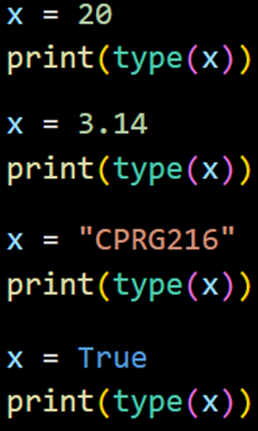

Objects
Everything is an object
An integer (20), a floating-point number (3.14), a string (“CPRG216”, and a Boolean (True) are all objects.
Every object has a type and a value:
Object Value | Object Type
data stored in the object | int, float, str, bool, etc.

Slide 12
Dynamic Typing
Statically-typed languages (C, Java, etc.) the variables’ types are determined at compile-time
Variables must be declared: Variable type must be specified
Dynamically-typed languages (Python) the variables types are determined at run-time
No variable declaration

Slide 13
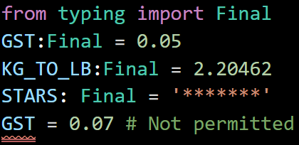
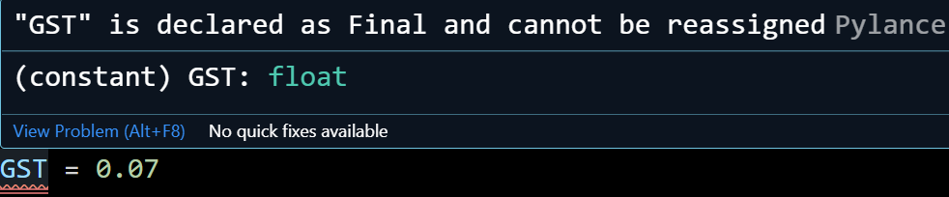
Constant
Special type of variable whose value cannot be changed.
Name should be in uppercase letters with underscores separating words
Example: GST, KG_TO_LB

Slide 14
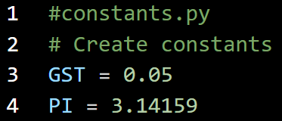

Constant
Constants are usually created in a module (i.e., PY file)

Slide 15
Type conversion/Casting
Type conversion is the process of converting the value of one data type to another datatype called type conversion.
Implicit casting – python interpreter automatically converts one datatype to another
e.g. x=10, y = 10.5
z = x + y what would be the type of z?

Slide 16
Type conversion/Casting
Explicit casting, you can also change a type directly
Example | What is x?
y = float(x) | x can include a group of numerical text characters
y = int(x) | x can include a group of numerical text characters
y = str(x) | y is x converted to a string
y = bool(x) | y is x converted to a Boolean True, or False

Slide 17
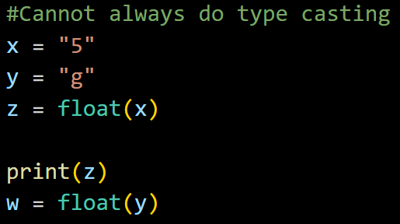
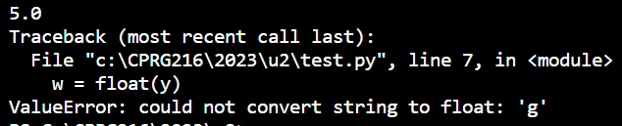
Type conversion/Casting
Explicit casting can’t always be done

Slide 18
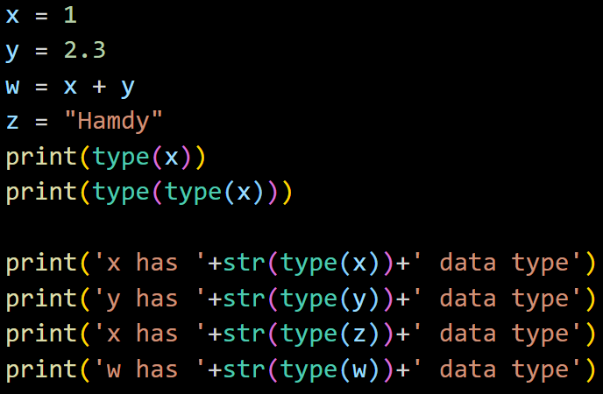
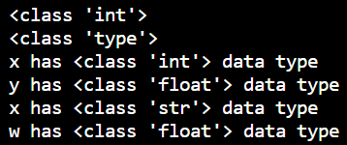
Type conversion/Casting
Converting the type object to string
Notes:
x = 1
y = 2.3
w = x + y
z = "Hamdy"
print(type(x))
print(type(type(x)))
print('x has '+str(type(x))+' data type')
print('y has '+str(type(y))+' data type')
print('x has '+str(type(z))+' data type')
print('w has '+str(type(w))+' data type')

Slide 19
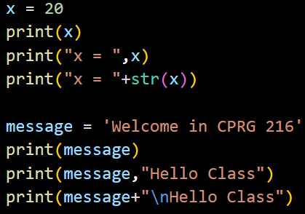
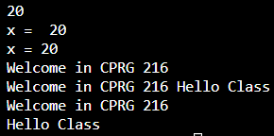
Print function
Built-in function which displays the specified message to the screen (i.e., standard output device).
Python print() Function (w3schools.com)

Slide 20
Escape Characters
Used to insert characters that are illegal in a string.
An escape character is a backslash \ followed by the character you want to insert.
Used to insert characters that are illegal in a string.
An escape character is a backslash \ followed by the character you want to insert.
Syntax | Effect
\t | Insert a horizontal tab
\n | Insert a newline character
\\ | Insert a backslash character in a string
\” | Insert a double quote character in a string
\’ | Insert a single quote character in a string
Syntax | Effect
\t | Insert a horizontal tab
\n | Insert a newline character
\\ | Insert a backslash character in a string
\” | Insert a double quote character in a string
\’ | Insert a single quote character in a string

Slide 21
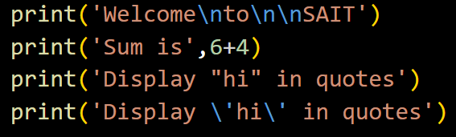
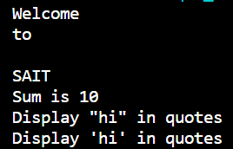
Escape Characters

Slide 22
Arithmetic Expressions
A combination of operators and operands (variables and/or values) and parenthesis
Expression is evaluated to a value
Operation | Operator | Syntax | Example
Addition | + | x + y | 6+7 → 13
Subtraction | - | x – y | 9-5 → 4
Multiplication | * | x * y | 4*5 → 20
Exponentiation | ** | X**y | 4**2 → 16
True division | / | x/y | 7/2 → 3.5
Floor division (quotient) | // | x//y | 7//2 → 3
Remainder (modulo) | % | a % b | 7%2 → 1

Slide 23
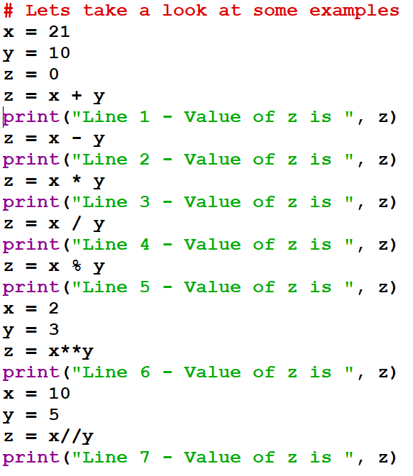
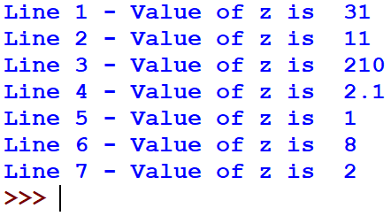
Arithmetic Expressions

Slide 24
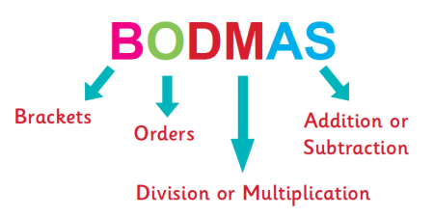
Precedence Rules
An expression is evaluated as per the precedence of its operators.
Expressions in parentheses
Exponentiation operations
Multiplication, division and modulus operations (if it contains several, apply the operations from left to right)
Addition and subtraction operations
https://www.11plus.co.uk/forum-topic/bodmas-or-not/

Slide 25
Augmented assignment Operators
Augmented assignment operator combines the functioning of the arithmetic or bitwise operator with the assignment operator.
abbreviate assignment expressions in which the a variable appears on the left and right of =
Example:
total = total + number ➔ total += number

Slide 26
Augmented assignment Operators
Operator | Expression | Equivalent | Result
x = 5
+= | x += 3 | x = x + 3 | x = 8
-= | x -= 3 | x = x – 3 | x = 2
*= | x *= 3 | x = x * 3 | x = 15
/= | x /= 2 | x = x / 2 | x = 2.5
//= | x //= 2 | x = x // 2 | x = 2
%= | x %= 2 | x = x % 2 | x = 1
**= | x **= 2 | x = x ** 2 | x = 25

Slide 27
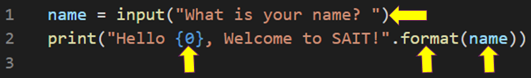

input Statement
A very common task in programming is asking for user input and assign it to a variable.
input() is used to get input from the user and return the entered value as a string

Slide 28
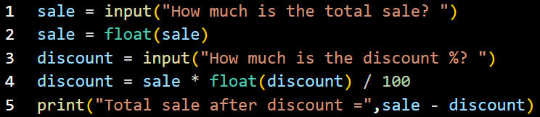

input Statement
Convert entered numeric values to int or float before processing it. Otherwise, they will be treated as string

Slide 29
Comments
A comment is a line(s) of code that is ignored by the interpreter.
Comments are internal documentation of the code
Written for programmers to make the code readable and understandable
Single-line comment starts with #.
Multiple-lines comment starts with ‘’’ or “””

Slide 30
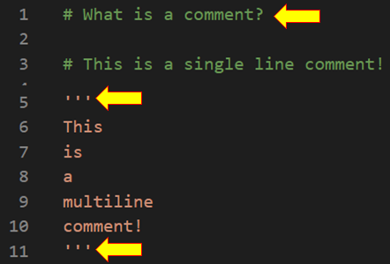
Comments

Slide 31
Exercise 2.1 – Real Estate summary
Write a program with two inputs, current price and last month's price (both integers). Then, output a summary listing the price, the change since last month, and the estimated monthly mortgage computed as (current_price * 0.051) / 12.
Task 1 | Task 2 | Task 3 - Outputs
Identify the inputs Choose meaningful names Types of variables | Math operations or Expression What formula I need? Change_price = current_price - last_months_price​ Monthly_Mortgage=(current_price * 0.051) / 12 | What are the outputs?​ Listing the price,​ The change since last month​ The estimated monthly mortgage

Slide 32
Exercise 2.2 - Volume and area of cylinder
The volume and area of a cylinder are calculated as:
Volume = πr²h
Area = 2πrh + 2πr²
Given the radius and height of a cylinder as floating-point numbers, output the volume and area of the cylinder.
Task 1 | Task 2 | Task 3 – Outputs
Identify the inputs Choose meaningful names Types of variables | Identify Math operations or Expression | What are the outputs?​

Slide 33
Homework Exercise 2.3 – working with variables and expressions
Kera is a mechatronics engineer working on a new type of high-performance vehicle. She needs a terminal-based program that will automatically compute the velocity and acceleration of her test vehicles. The available input is as follows:
Starting position (in meters) Ending position (in meters) Starting time (in seconds) Ending time (in seconds)
Note: You may assume that the ending values will always be larger than the starting values.

